Slide 1

AL-FARABI KAZAKH NATIONAL UNIVERSITY
Department of political science and political technologies
Political conflict studies
Abzhapparova A.A.
Senior lecturer

Slide 2
Political conflict studies
Lecture 2
Political conflicts: concept, essence and features.

Slide 3
Lecture plan:
1. Methodological foundations of the theory of political conflicts
2. Specifics of political conflicts

Slide 4
Etymology of the word "conflict"
The word conflict appeared in the Russian language in the middle of the 19th century. First in the form Konflikt'ktъ , borrowed from German, where Konflikt <Latin conflictus , suffix of a derivative of confligere "to fight, to struggle". Konflikt literally means "clash, battle" [ V.I.Dal ]
In the dictionary of D.N. Ushakov, conflict is given the following meaning: “Conflict is a clash between disputing, disagreeing parties.”

Slide 5
the concept of "conflict
conflict
rivalry
competition

Slide 6
POWER AND CONFLICT
a power relationship arises only when there is a conflict between the subject and the object and the subject acts against the interests (desires, preferences, intentions, goals) of the object (P. Bachrach and M. Baratz ),
They write about conflict behavior and conflict of preferences
other researchers deny the need to include conflict among the obligatory elements of power ( T. Parsons , J.-E. Lane , E. Giddens , E. De Crespini , F. Oppenheim and F. Frey )

Slide 7
three main approaches to understanding and the role of conflicts in society
the first is the recognition of the fundamental inevitability and inescapability of life, the leading role of conflicts in social development
the second is the rejection of conflicts that manifest themselves as wars, revolutions, class struggle, social experiments, recognition of them as anomalies of social development that cause instability, disruption of the balance in socio-economic and political systems
the third is the consideration of conflict as one of many types of social interaction and social contacts along with competition, solidarity, cooperation, partnership

Slide 8
The concept of social Darwinism
1.an inevitable phenomenon in the history of human society
2.social form of struggle for existence
3. incentive and the most important mechanism of social development
the struggle for existence is caused by the spontaneous desire of people for self-preservation and accumulation of vital resources
From this, a conclusion is drawn about the natural desire of some races and peoples to subjugate others and dominate them, which is the supreme law of natural evolution.

Slide 9
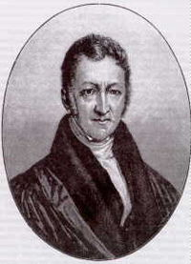
Thomas Robert Malthus
(1766-1834)
- English
priest and scientist, demographer and eco-economist , author of the theory that uncontrolled population growth should lead to famine on Earth
In 1798 In that year he published his book, An Essay on the Principle of Population .
Formulates the natural law:
The population is growing exponentially, and the means of subsistence are growing arithmetically.
Hence, the reasons for the people’s plight are rooted in their unreasonable reproduction.
The struggle of people for the means of existence becomes an inevitable phenomenon
All kinds of conflicts become a permanent factor in social development

Slide 10
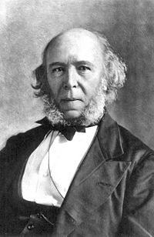
Herbert Spencer (1820-1903)
considered social conflict from the standpoint of social Darwinism, considered it an inevitable phenomenon in the history of society and an incentive for social development
put forward the thesis about the generality and universality of conflicts
The struggle for survival, conflicts between individuals and groups contribute to the balance in society, ensuring the process of social development
Society can be identified with an organism, biological laws are applicable to it
Three formulas for explaining social evolution: “natural selection”, “struggle for existence”, “survival of the fittest”

Slide 11
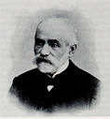
GUMPLOWICZ Ludwig (1838-1909) - Polish-Austrian sociologist and lawyer, founder of the theory of "social conflict", " ethnocentrism ", original theories of the origin of the state, races and laws of social development. Main works: "Race and the State" (1875), "Race Struggle" (1883
Society is a collection of groups of people who mercilessly fight among themselves for influence, survival and dominance.
Its driving force is the desire of social groups for self-preservation and constant improvement of their well-being. This desire in turn "leads to the desire to dominate other social groups and their enslavement, which, when confronted with similar desires of other groups, leads to a struggle for power over other social groups."
The entire history of human development is a continuous struggle of social groups.
The basic social law is the desire of each social group to subjugate another social group.
The source of conflict is not only in human nature, but also in social phenomena of different types of cultures.

Slide 12
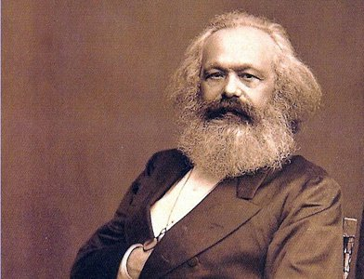
The doctrine of conflict by K. Marx
the source of the conflict is in the vicious structure of society itself, thanks to which some have the opportunity to appropriate the results of the labor of others
social conflict is reproduced by societies with a class structure
Conflict is inherent in such societies due to inequality and differences in the position of social classes in the system of social division of labor. The main struggle between them is over production and property relations
Conflict is an inevitable condition for revolutionary change in society . Inevitable violence is justified as the midwife of history, a factor that accelerates development, removing obstacles to the creation of a just classless society in which there will no longer be a basis for social conflict.

Slide 13
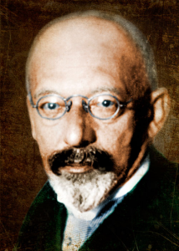
conflict in the sociology of Georg Simmel
Conflict in society is inevitable and unique, inevitability is inherent in human nature itself. One of the main sources of the emergence and development of conflicts is the aggressiveness inherent in people, the a priori instinct of struggle, the primary need for hostility.
The history of culture can be understood as a history of conflicts and reconciliations, similarities and differences between people and social groups
The main function of conflict is that it promotes the emergence and strengthening of group identity and maintains boundaries with the social environment
Conflict is meant to resolve any dualism: it is a way of achieving a kind of unity, even if it is achieved at the cost of destroying one of the parties involved in the conflict.
Conflict prevents the destruction of the group through the departure of hostile members

Slide 14
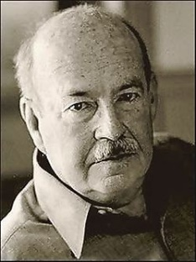
Talcott's theory of social action Parsons (functionalists )
conflict is dysfunctional , destructive and destructive
Conflict is a social anomaly, a “disaster” that must be overcome.
instead of the term conflict uses the category of "tension "
Parsons formulated a number of social prerequisites that ensure the stability of society:
· satisfaction of the basic biological and psychological needs of the majority of society;
· effective activities of social control bodies that educate citizens in accordance with the norms accepted in a given society;
· coincidence of individual motivations with social attitudes.

Slide 15
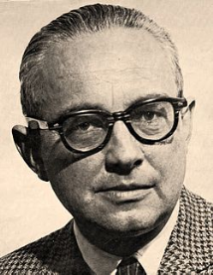
Coser's
social conflict is reduced to tension between what is and what should be in accordance with the feelings of certain groups and individuals
a constant source and cause of modern social conflicts is the lack of resources, not only material, but also political, resources of power , prestige, which exist in any society
As long as society exists, there will be tension, there will be conflicts, and the struggle of people for power, prestige, and respect will play a special role.
In closed societies, conflict undermines social harmony and threatens to destroy the social order through revolutionary violence.
In open societies there are many conflicts between different strata and groups, but there are social institutions that protect social harmony and turn the energy of conflicts to the benefit of society.
the more independent conflicts there are, the better for the unity of society
Social conflicts can perform two types of functions: negative (destructive) and positive (constructive)
Conflict is behavior that involves struggle between opposing parties over scarce resources and involves an attempt to neutralize, harm, or eliminate an opponent .

Slide 16
negative functions of conflict
deterioration of the social climate, reduction in labor productivity, dismissal of some workers in order to resolve the conflict;
inadequate perception and misunderstanding of each other by the conflicting parties;
decreasing cooperation between conflicting parties during and after the conflict;
a spirit of confrontation that draws people into struggle and makes them strive for victory at all costs rather than for solving real problems and overcoming differences;
material and emotional costs of resolving the conflict.

Slide 17
Positive functions of social conflict
conflict does not allow the existing system of relations to freeze and ossify, it pushes it towards change and development, opens the way for innovations that can improve it;
plays a communicative, informational and connecting role, since during the conflict its participants get to know each other better;
conflict contributes to the structuring of social groups, the creation of organizations, and the consolidation of teams of like-minded people;
relieves the syndrome of submission, stimulates people's activity;
stimulates personal development, the growth of people’s sense of responsibility, and their awareness of their own importance;
unleashing a conflict relieves underlying tension and gives it an outlet (conflict as an exhaust valve);
the conflict performs a diagnostic function;
conflict contributes to the creation of new forms and social institutions, i.e. the function of norm-setting).

Slide 18
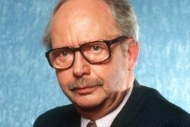
Dahrendorf's
All social life is a conflict because it is changeable
It is precisely in conflict that the creative core of all communities and the possibility of freedom are found, as well as the challenge to rational mastery and control over social problems
the main cause of the conflict is the relationship of dominance and subordination, power relations, inequality of different social groups in the social structure of society
Three main ways of conflict resolution:
suppression;
cancellation by eliminating the contradiction;
regulation
Conflict is "any relationship between elements that can be characterized by objective (latent) or subjective (manifest) opposites"

Slide 19
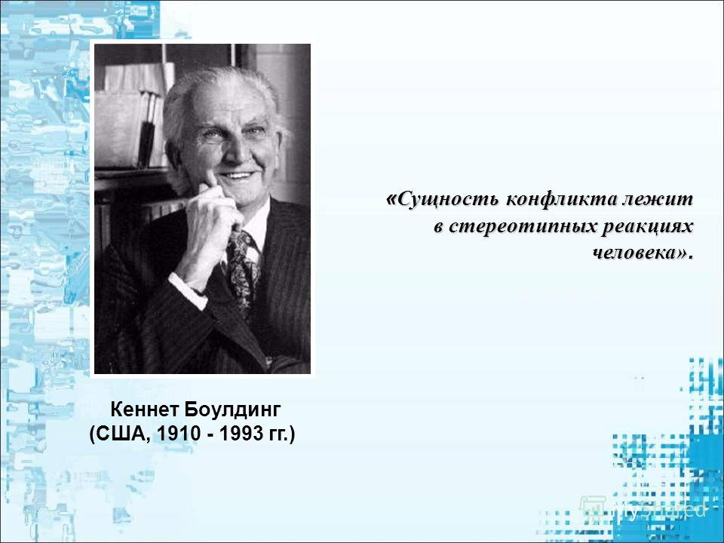
Kenneth Boulding's General Theory of Conflict
Conflict is inseparable from social life
Conflict is a situation in which the parties recognize the incompatibility of their positions and each party seeks to take a position opposite to the interests of the other
conflicts are a type of social interaction where the parties are aware of both their opposition and their attitude towards it. They are consciously organized, developing a strategy and tactics of struggle

Slide 20
POLITICAL CONFLICT
The leading source of policy underlying what is happening
changes in it and thereby determining its boundaries and the nature of its existence
Conflict is secondary to understanding the essence of politics
Conflict is an anomaly of the political process
The aim of the policy is to maintain “social homogeneity” or to exert “pedagogical influence” on society to prevent conflicts
Destabilization of power and disintegration of society arise not because conflicts arise, but because of the inability to regulate political contradictions

Slide 21
Political conflict
this is a clash (confrontation) between two or more subjects (parties) of politics, the causes of which are incompatible political interests, goals and values, directly or indirectly related to political (state) power

Slide 22
Three reasons underlying political confrontation
1. Various forms and aspects of social relations that determine the discrepancy between the statuses of political subjects, their role assignments and functions, interests and needs in power, lack of resources, etc.
2. Differences between people (their groups and associations) in basic values and political ideals, in assessments of historical and current events, as well as in other subjectively significant ideas about political phenomena.
3. The processes of identification of citizens, their awareness of their belonging to social, ethnic, religious and other communities and associations, which determines their understanding of their place in the social and political system.

Slide 23
Features of political conflict
The publicity and open nature of the manifestation of the confrontation between the parties.
Universal significance.
Conditionality by power (power relations).
Institutional organization
Conflict of mutual intentions of the parties
Legal conflicts

Slide 24
The structure of political conflict
two or more opposing parties (subjects) of a conflict;
object (subject) of the conflict;
indirect aspects of the conflict (as a probabilistic element of the structure);
third party (as a probabilistic element of the structure);
surrounding social environment (social and political field).

Slide 25
Subjects of political conflict
a real or potential subject of political relations, possessing certain political resources, having his own political interests and ready to defend them (already defending them) in a real political confrontation.
These are individuals, groups, organizations, work collectives, social communities, political institutions, states, due to certain reasons and circumstances, involved in the conflict and taking part in it.

Slide 26
Third party to the conflict
The functions and importance of the third party in the negotiation process are largely determined by its status in the negotiations. M. M. Lebedeva identifies the following functions of the third party:
mediation - participation in the negotiation process with the aim of optimizing the process of finding a mutually acceptable solution. It is carried out with the mutual consent of the negotiating parties;
rendering "good offices" - this function is less significant and binding than mediation. It may be limited, for example, to providing one's territory for negotiations or facilitating the establishment of communications. Rendering good offices is possible with the consent of even one party;
monitoring the progress of negotiations - observers, by the very fact of their presence at the negotiations, create conditions for reducing tension between the parties and promote constructive dialogue, but they themselves are not directly involved in the negotiation process;
arbitration - its main difference is that the decisions made by the arbitrator become binding on each of the parties

Slide 27
third party qualities and characteristics
political capital - experience in developing and making important political decisions, in successfully resolving complex political contradictions;
competence - knowledge and skills necessary for the successful resolution of specific (typical) conflicts;
authority and trust of the contracting parties and the public;
impartiality - the position of the third party in the negotiation process should be as neutral as possible.

Slide 28
The main stages of development of political conflict
Origin (formation)
Development (practical actions)
permission
potential tension caused by the existing object of conflict;
transition of potential tension into real tension;
the emergence of a conflict situation;
awareness by social groups of the opposition of their interests and the formation of a subject of the conflict;
creating an incident to initiate real conflict interaction;
conflict interaction .
open opposition
conflict resolution: conflict extinction or transformation
Removing contradictions

Slide 29
stages of political conflict
1) a latent stage, characterized by the unequal status of two (or more) groups, accompanied by constant attempts to improve their position and primacy;
2) the stage of tension, divided according to its degree of increase into three levels – zero, medium and high;
3) the stage of antagonism, arising from a state of tense situation, especially with the simultaneous combination of its structural and conjuncture varieties;
4) incompatibility as the final result of a situation of tension,
the conflict itself

Slide 30
The driving force behind political conflict
an identity crisis, when, due to the destruction of ideals and values that dominate the political system, the need for them disappears;
a crisis in the distribution of material and spiritual resources, representing the failure of government structures to ensure sustainable growth in the material well-being of the population;
crisis of participation – the degree of citizen participation in governance; - crisis of “penetration” – the desire on the part of ruling circles to impose their decisions at all levels of social life;
legitimacy crisis – a discrepancy between the stated goals of the existing regime and public perceptions of the rules of its functioning.

Slide 31
Typology of political conflicts
Internal political conflicts are conflicts that arise within society, within a political system, a political party or other socio-political organization.
long and short-term conflicts
acute ,
rapidly developing, fading, growing conflicts
"deep" and "shallow" (in people's minds) conflicts
"zero-sum" and "non-zero -sum".

